Slide 1
CHAPTER 3 (Part 1)
Data Storage

Slide 2
Objectives
After studying this chapter, the student should be able to:
List five different data types used in a computer.
Describe how different data is stored inside a computer.
Describe how integers are stored in a computer.
Describe how reals are stored in a computer.
Describe how text is stored in a computer using one of the various encoding systems.
Describe how audio is stored in a computer using sampling, quantization, and encoding.
Describe how images are stored in a computer using raster and vector graphics schemes.
Describe how video is stored in a computer as a representation of images changing in time.

Slide 3
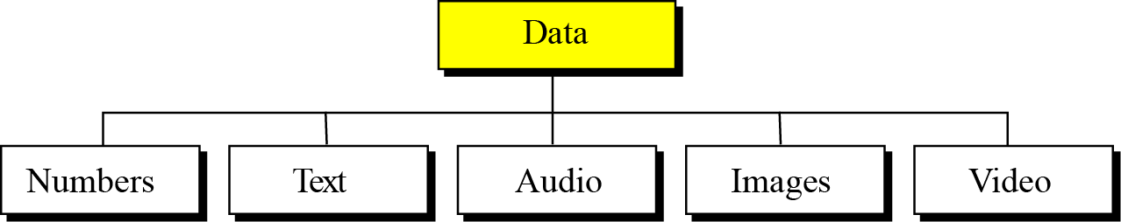
3-1 INTRODUCTION
Data today come in different forms including numbers, text, audio, image, and video (Figure 3.1).
Figure 3.1 Different types of data

Slide 4

i
The computer industry uses the term “multimedia” to define information that contains numbers, text, images, audio, and video.

Slide 5
3.1.1 Data inside the computer
All data types are transformed into a uniform representation when they are stored in a computer and transformed back to their original form when retrieved. This universal representation is called a bit pattern.
Figure 3.2 A bit pattern

Slide 6
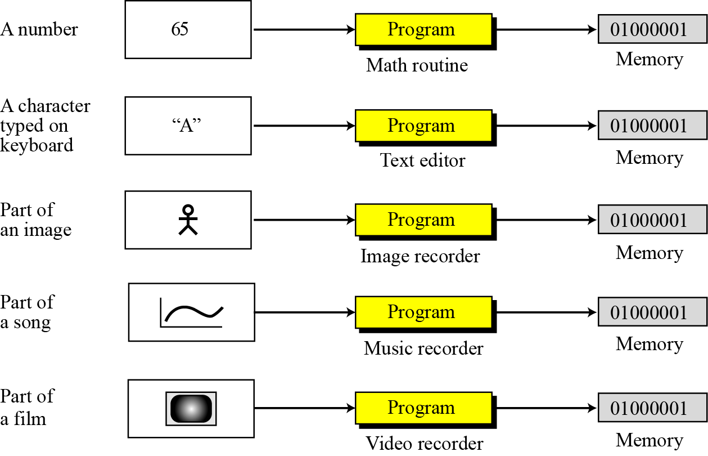
Figure 3.3 Storage of different data types

Slide 7
3.1.2 Data compression
To occupy less memory space, data is normally compressed before being stored in the computer. Data compression is a very broad and involved subject, so we have dedicated the whole of Chapter 15 to this subject.
i
Data compression is discussed in Chapter 15.

Slide 8
3.1.3 Error detection and correction
Another issue related to data is the detection and correction of errors during transmission or storage. We discuss this issue briefly in Appendix H.
i
Error detection and correction is discussed in Appendix H.

Slide 9
3-2 STORING NUMBERS
A number is changed to the binary system before being stored in the computer memory, as described in Chapter 2. However, there are still two issues that need to be handled:
How to store the sign of the number.
How to show the decimal point.

Slide 10
3.2.1 Storing integers
Integers are whole numbers (numbers without a fractional part). For example, 134 and −125 are integers, whereas 134.23 and −0.235 are not. An integer can be thought of as a number in which the position of the decimal point is fixed: the decimal point is to the right of the least significant (rightmost) bit. For this reason, fixed-point representation is used to store an integer, as shown in Figure 3.4. In this representation the decimal point is assumed but not stored.

Slide 11
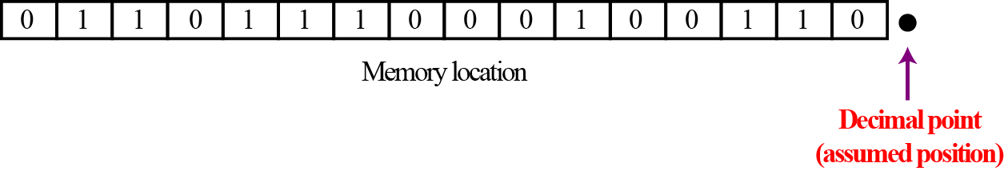
Figure 3.4 Fixed point representation of integers
i
An integer is normally stored in memory using fixed-point representation.

Slide 12
Unsigned representation
An unsigned integer is an integer that can never be negative and can take only 0 or positive values. Its range is between 0 and positive infinity.
An input device stores an unsigned integer using the following steps:
The integer is changed to binary.
If the number of bits is less than n, 0s are added to the left.

Slide 13
Example 3.1
Store 7 in an 8-bit memory location using unsigned representation.
Solution
First change the integer to binary, (111)₂. Add five 0s to make a total of eight bits, (00000111)₂. The integer is stored in the memory location. Note that the subscript 2 is used to emphasize that the integer is binary, but the subscript is not stored in the computer.

Slide 14
Example 3.2
Store 258 in a 16-bit memory location.
Solution
First change the integer to binary (100000010)₂. Add seven 0s to make a total of sixteen bits, (0000000100000010)₂. The integer is stored in the memory location.

Slide 15
Example 3.3
What is returned from an output device when it retrieves the bit string 00101011 stored in memory as an unsigned integer.
Solution
Using the procedure shown in Chapter 2, the binary integer is converted to the unsigned integer 43.

Slide 16
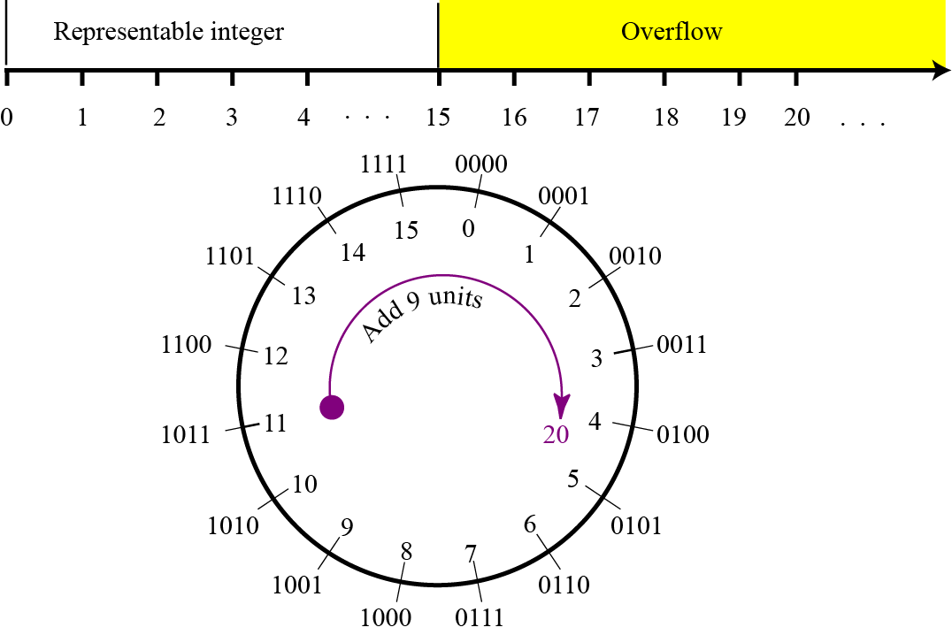
Figure 3.5 shows what happens if we try to store an integer that is larger than 2⁴ − 1 = 15 in a memory location that can only hold four bits.
Figure 3.5 Overflow in unsigned integers

Slide 17
Sign-and-magnitude representation
In this method, the available range for unsigned integers (0 to 2^{n} − 1) is divided into two equal sub-ranges. The first half represents positive integers, the second half, negative integers.
Figure 3.6 Sign-and-magnitude representation
i
In sign-and-magnitude representation, the leftmost bit defines the sign of the integer. If it is 0, the integer is positive. If it is 1, the integer is negative.

Slide 18
Example 3.4
Store +28 in an 8-bit memory location using sign-and-magnitude representation.
Solution
The integer is changed to 7-bit binary. The leftmost bit is set to 0. The 8-bit number is stored.

Slide 19
Example 3.5
Store −28 in an 8-bit memory location using sign-and-magnitude representation.
Solution
The integer is changed to 7-bit binary. The leftmost bit is set to 1. The 8-bit number is stored.

Slide 20
Example 3.6
Retrieve the integer that is stored as 01001101 in sign-and-magnitude representation.
Solution
Since the leftmost bit is 0, the sign is positive. The rest of the bits (1001101) are changed to decimal as 77. After adding the sign, the integer is +77.

Slide 21
Example 3.7
Retrieve the integer that is stored as 10100001 in sign-and-magnitude representation.
Solution
Since the leftmost bit is 1, the sign is negative. The rest of the bits (0100001) are changed to decimal as 33. After adding the sign, the integer is −33.

Slide 22
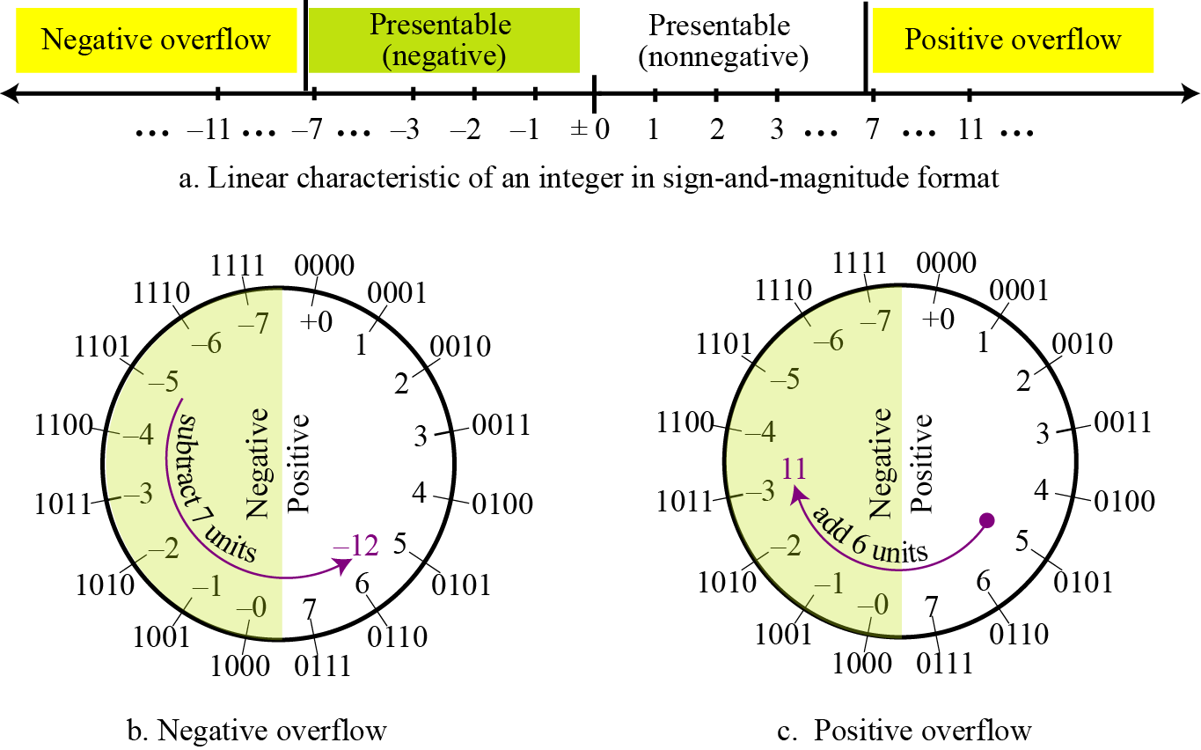
Figure 3.7 shows both positive and negative overflow when storing an integer in sign-and-magnitude representation using a 4-bit memory location.
Figure 3.7 Overflow in sign-and-magnitude representation

Slide 23
Two’s complement representation
Almost all computers use two’s complement representation to store a signed integer in an n-bit memory location. In this method, the available range for an unsigned integer of (0 to 2^{n} − 1) is divided into two equal sub-ranges. The first sub-range is used to represent nonnegative integers, the second half to represent negative integers. The bit patterns are then assigned to negative and nonnegative (zero and positive) integers as shown in Figure 3.8.

Slide 24
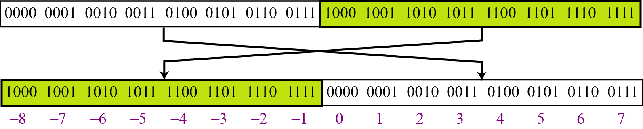
Figure 3.8 Two’s complement representation
i
In two’s complement representation, the leftmost bit defines the sign of the integer. If it is 0, the integer is positive. If it is 1, the integer is negative.

Slide 25
One’s Complementing
Before we discuss this representation further, we need to introduce two operations. The first is called one’s completing or taking the one’s complement of an integer. The operation can be applied to any integer, positive or negative. This operation simply reverses (flips) each bit. A 0-bit is changed to a 1-bit, a 1-bit is changed to a 0-bit.
Example 3.8
The following shows how we take the one’s complement of the integer 00110110.

Slide 26
Example 3.9
The following shows that we get the original integer if we apply the one’s complement operations twice.

Slide 27
Two’s Complementing
The second operation is called two’s completing or taking the two’s complement of an integer in binary. This operation is done in two steps. First, we copy bits from the right until a 1 is copied; then, we flip the rest of the bits.
Example 3.10
The following shows how we take the two’s complement of the integer 00110100.

Slide 28
Example 3.11
The following shows that we always get the original integer if we apply the two’s complement operation twice.
i
An alternative way to take the two’s complement of an integer is to first take the one’s complement and then add 1 to the result.

Slide 29
Example 3.12
Store the integer 28 in an 8-bit memory location using two’s complement representation.
Solution
The integer is positive (no sign means positive), so after decimal to binary transformation no more action is needed. Note that five extra 0s are added to the left of the integer to make it eight bits.

Slide 30
Example 3.13
Store −28 in an 8-bit memory location using two’s complement representation.
Solution
The integer is negative, so after changing to binary, the computer applies the two’s complement operation on the integer.

Slide 31
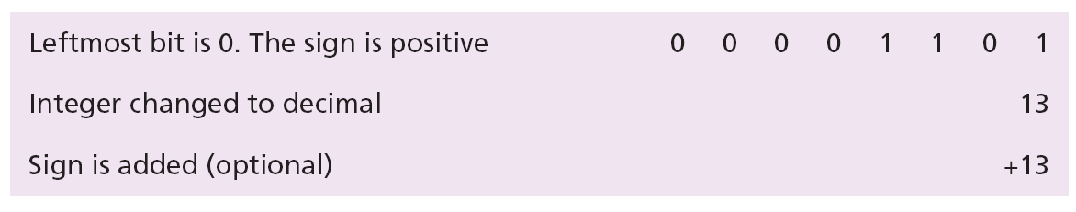
Example 3.14
Retrieve the integer that is stored as 00001101 in memory in two’s complement format.
Solution
The leftmost bit is 0, so the sign is positive. The integer is changed to decimal and the sign is added.

Slide 32
Example 3.15
Retrieve the integer that is stored as 11100110 in memory using two’s complement format.
Solution
The leftmost bit is 1, so the integer is negative. The integer needs to be two’s complemented before changing to decimal.

Slide 33
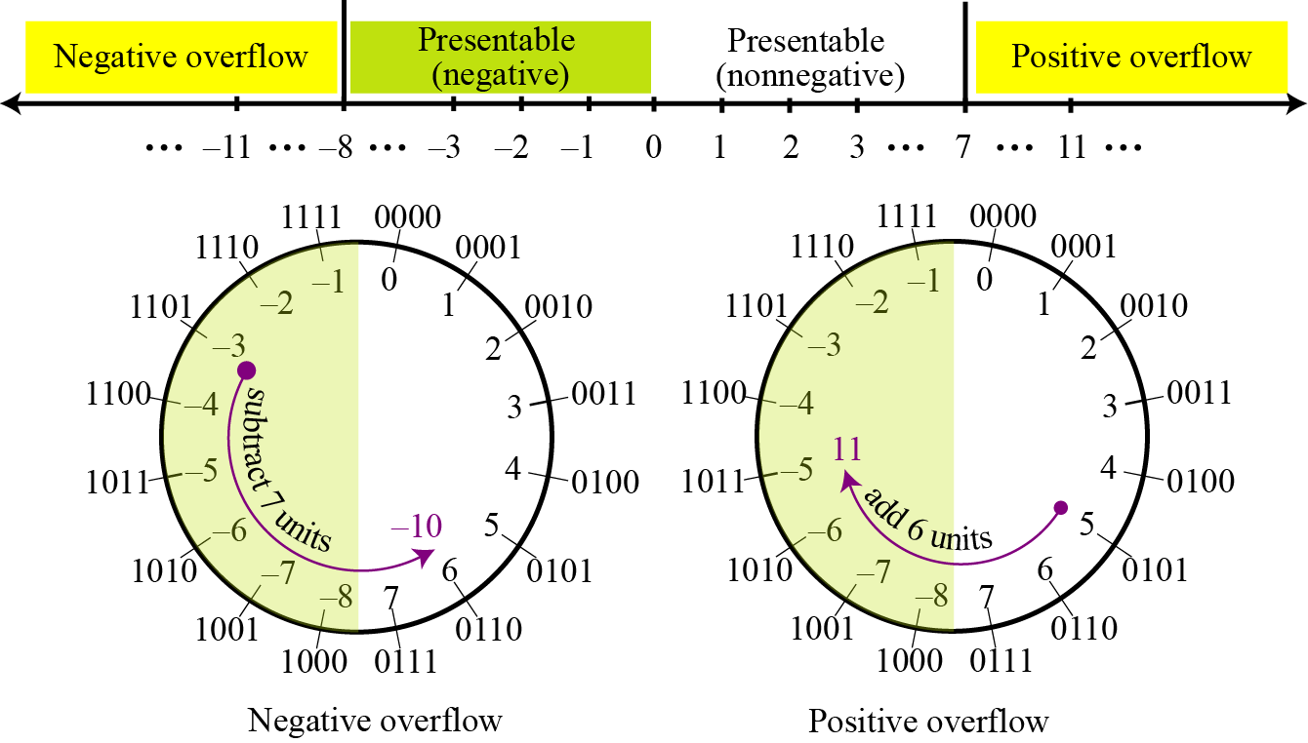
i
There is only one zero in two’s complement notation.
Figure 3.9 Overflow in two’s complement representation

Slide 34
3.2.2 Comparison of the three systems

Slide 35
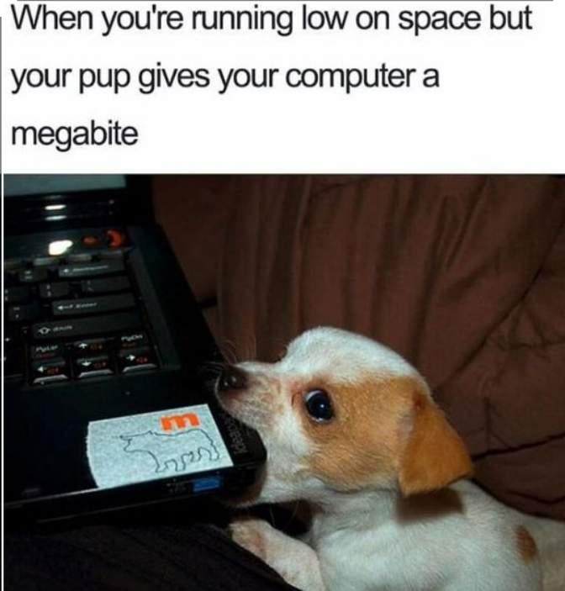
The End

